Slide 1


Trend analyses & forward-looking modelling in Swiss Re’s underwriting
Matt Weber, Swiss Re
January 18, 2018

Slide 2
Agenda
Economic function of re/insurance Swiss Re at a glance
Trend analyses
Forward-looking modelling

Slide 3
Role of re/insurers



☞

Living life and running business involve risks
To mitigate these risks, individuals and companies buy insurance
Insurance companies need to protect themselves, too, and do so by buying reinsurance
Reinsurance is essentially insurance for insurance companies
Reinsurance is one of the few industries that is, and always has been, truly global in nature
Motor
Home
Life/health
Business
Catastrophe
Primary insurer
Primary insurer
Primary insurer
Premium
Claim payment
Reinsurer
Other reinsurer
Capital markets through securitisation

Slide 4

Role of re/insurers A catalyst for economic growth
Risk transfer function
Diversifies risks on a global basis
Capital market function
Invests premium income according to expected pay-out (institutional investor)
Information function
Puts a price tag on risks
Reinsurers absorb shocks, provide capital for the real economy and support efficient risk prevention
Notes:
Benefit to society Pre-requisites
Make insurance more broadly Global mobility of premiums and available and less expensive capital
Provide long-term capital to Ability to invest in real economy
the economy on a continuous (equity, corporate bonds, etc)
basis
Set incentives for risk- Market- and risk-based pricing
adequate behaviour

Slide 5

Swiss Re at a Glance

Slide 6

Swiss Re is broadly diversified
Swiss Re benefits from geographic and business mix diversification and has the ability to swiftly reallocate capital to achieve profitable growth.
Swiss Re Group net premiums earned 2016 USD 33.2 billion
15.1 45%
10.9 33%
7.2 22%
Key statistics (USD billions) | FY 2012 | FY 2013 | FY 2014 | FY 2015 | FY 2016
Total revenues | 33.6 | 37.3 | 37.3 | 35.7 | 43.8
Net income | 4.2 | 3.5 | 3.5 | 4.6 | 3.6
Shareholders’ equity | 34.0 | 36.0 | 35.9 | 32.4 | 34.5

Slide 7
We make the world
more resilient
OUR MISSION: Together, we apply fresh perspectives, knowledge and capital to anticipate and manage risk. That’s how we create smarter solutions for our clients, helping the world rebuild, renew, and move forward.

Slide 8
What differentiates Swiss Re
Size
allows us to make investments into:
Client relationships
built through unique access and long-term partnerships
Knowledge
which allows us to develop better products with and for our clients

Slide 9

What differentiates Swiss Re A knowledge company with top talent
Examples
Property
Climate change
Hurricane, EQ, flood
Cyber
Casualty
US liability
US motor
Specialty
Credit default probabilities
Life & Health
Mortality / morbidity
Lapse
Pandemic modelling

Slide 10
Importance of understanding loss trends
OUR MISSION: Together, we apply fresh perspectives, knowledge and capital to anticipate and manage risk. That’s how we create smarter solutions for our clients, helping the world rebuild, renew, and move forward.
Getting losses and loss trends right (→ cost of goods sold) is critically important: A small estimation mistake typically has a large impact on the bottom line!

Slide 11
Trend analysis and forward-looking modelling approach
Forward- looking loss trends
Capital allocation
Identify drivers affecting UW trends
Analyse impact of drivers on UW trends
Predict future
of relevant drivers
Forward-looking lapse rates
(specific to L&H)
Costing
(experience rating approach)
Forward-
looking modelling
Costing
(exposure rating approach)

Slide 12
Trend analyses

Slide 13
US P&C Agent E&O Past loss ratio is not a good predictor for what will happen in the future
Context | Insurance industry estimates for US P&C agent E&O losses have often been wrong Past loss ratio is not a good predictor for what could happen in the future
Drivers that explain history | We developed an econometric model that explains a significant amount of the past loss variability Driver forecasts enable us to forecast loss trends for US P&C agent E&O
Correlation of our model with past industry-wide loss ratios

Slide 14
US commercial motor Trucking losses are strongly linked to construction employment
Context | Industry experienced a worsening of US commercial motor losses starting in 2010, to a large extent driven by trucks, tractors and trailers (TTT)
Drivers that explain history | By means of an econometric analysis we found that the recent rise in commercial motor losses after the GFC was driven by a general hiring of less experienced drivers increase in tonnage transported We also found a strong correlation between construction employment and the overall TTT loss burden in the US
Predicted vs actual TTT loss trends

Slide 15
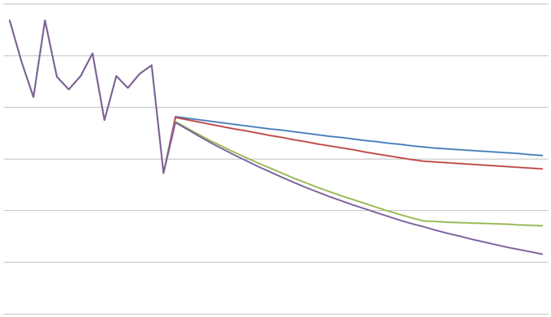
Long-term mortality trend Experts providing insights into future health drivers
Context | Multi-pillared approach Zero to 20-year mortality trend: extra-polated from past experience 20+ year mortality trend: combination of → expert scenarios relating to future developments, and → extrapolated patient treatment and outcome data | Example: Circulatory disease mortality projection using disease progression data from patient medical records and forward-looking scenarios to produce predictions of long-term mortality improvements and life expectancy changes
Drivers that explain history | Long-term mortality trend drivers include: → health hazards (e.g. reoccurring endemic diseases, antibiotic resistance) → developments in medicine → human behavior (e.g. smoking, adoption of novel medical procedures) → healthcare delivery / financing (e.g. government health programs) Accuracy depends on the quality and diversity of expert opinions
Four stroke risk scenarios for males aged 70-74
0.006
0.005
0.004
0.003
0.002
0.001
0
2030 trend
Post 2030 trend
% of mortality improvements
Prime
Alternate
External
Trend
1995 | 2000 | 2005 | 2010 | 2015 | 2020 | 2025 | 2030 | 2035 | 2040

Slide 16
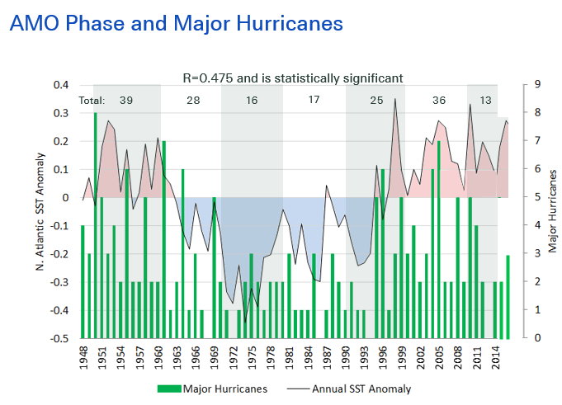
US hurricanes Cyclicality of hurricane activity identified, forecasts remain challenging
Context | Strength of the Gulf Stream in the North Atlantic oscillates with a periodicity of approximately 50 years Known as the Atlantic Multi-decadal Oscillation (AMO)
Drivers that explain history | AMO influences the average sea surface temperature (SST) in the North Atlantic, which in turn affects hurricane activity Correlation between SST and hurricane activity is statistically significant Current warm phase started approximately in 1995 No consensus among scientists on when the next cold phase might start
SST anomaly
- Monthly
- 3-year moving average

Slide 17
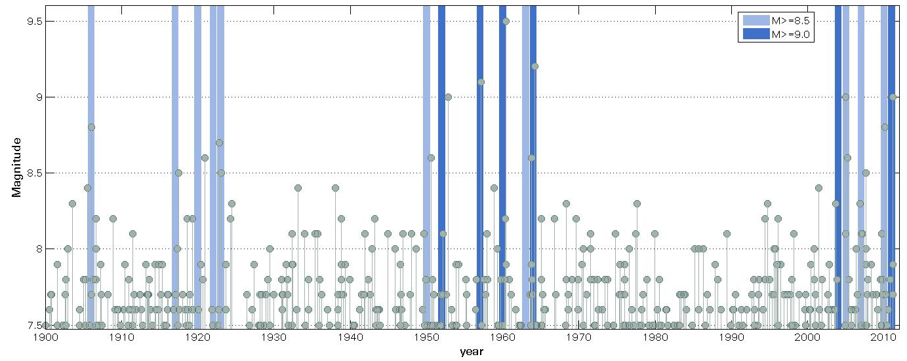
Do big earthquakes cluster?
Based on earthquake (EQ) records over the last 105 years, we expect 1 earthquake larger than Magnitude (M) 8.5 every 7 years.
Since 2004, 5 earthquakes of M≥ 8.5 have occurred (1 in 2.8 years).
Between 1950 and1964, 6 earthquakes of M≥8.5 occurred (1 in 1.8 years).
Between 1906 and 1923, 5 earthquakes of M≥8.5 occurred (1 in 3.4 years).
2011 Japan earthquake is among five M9.0 and larger events observed since 1900.
1906 - 1923
1950 - 1964
>2004
Chile
It appears that M≥8.5 EQs occur in cycles lasting about 15 years, each separated by several quiet decades
Kamtschatka
Alaska
Sumatra
Japan
Chile

Slide 18
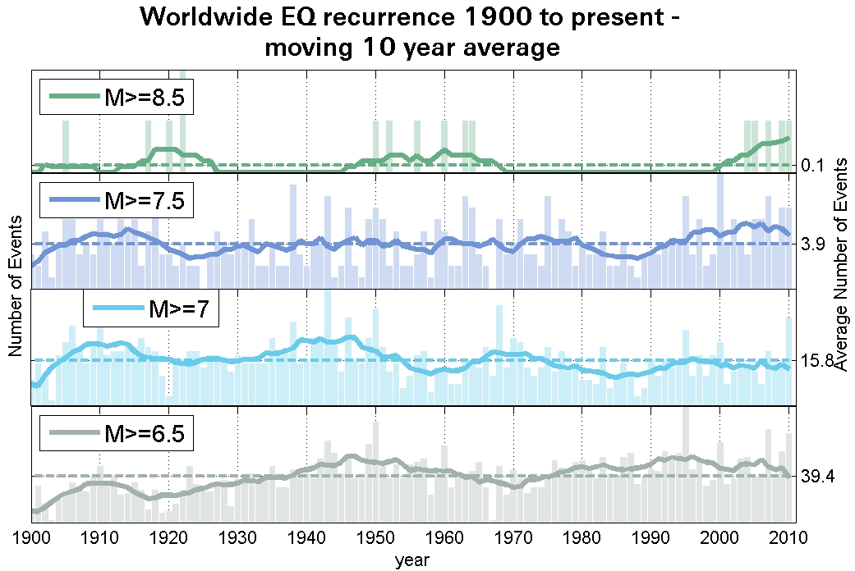
Inconsistencies by size
Earthquakes smaller than M8.5 also show periods of above- or below-average activity.
However, these periods are different for each magnitude band.
Bars: single observations Lines: 10 year moving average
There is no plausible theory that would explain why periods of above- or below-average EQ activity are different for each magnitude band.
This poses the question as to whether observed global clustering of M≥8.5 EQs is more than just coincidence.

Slide 19

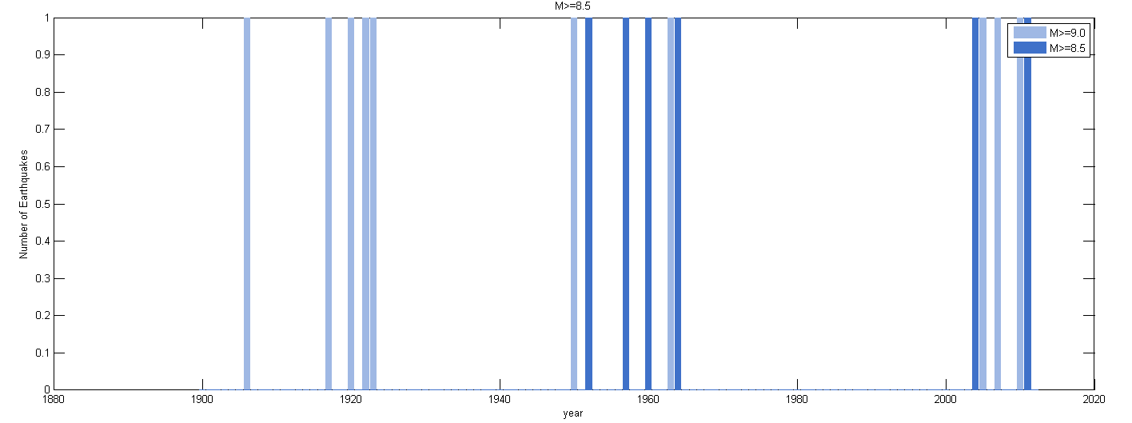
What do the statistics say?
A basic assumption in seismology is that earthquakes occur randomly in time.
A statistical test was performed to test this hypothesis: While M≥ 8.5 EQ clustering cannot be completely ruled out, there is a chance that this apparent clustering is pure coincidence.
1906 - 1923
1950 - 1964
>2004
There is no conclusive statistical evidence of global clustering of M≥8.5 earthquakes.

Slide 20
What does science say?
Scientists agree that earthquakes influence each other on a regional scale (→ up to within a few hundred kilometers).
Most scientists assume that, on a global scale, M≥ 8.5 earthquake events are independent of each other and randomly distributed over time. Scientists mostly consider theories that would explain M≥ 8.5 earthquake clustering to be pure speculation.
However, there are also dissenting opinions within the scientific community and the debate is ongoing.
There is no consensus in science regarding global clustering of M≥8.5 earthquakes. However, most scientists assume that such earthquakes are independent from each other and randomly distributed over time.

Slide 21
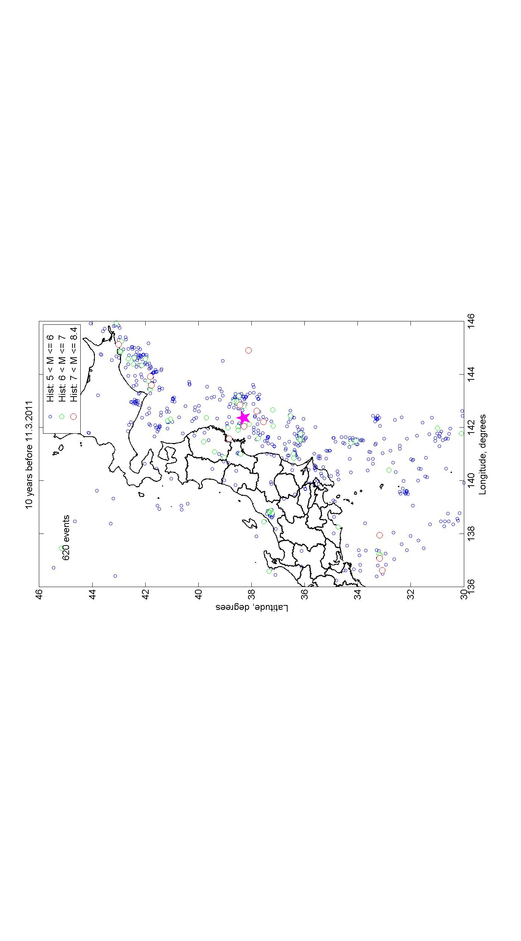
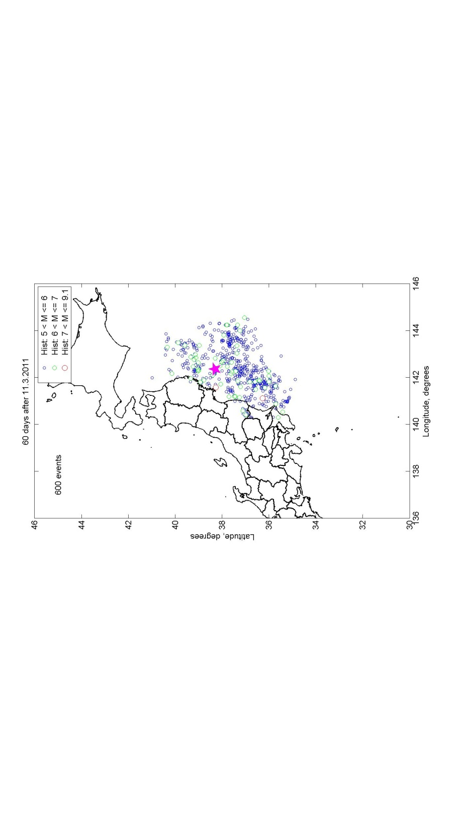

However, aftershocks exist and clearly matter
Large EQs trigger aftershocks: smaller EQs that occur closely in space and time
Japan EQs observed during 60-day period after 11 March, 2011 equals number of events during 10-year period before
Aftershocks can cause material losses (e.g. Christchurch EQ in 2011)
Most models do not consider aftershocks resulting in underestimation of risk
2nd event probability for EQs is generally underestimated
2011 M9.0
2011 M9.0
620 events in 10 years before 11 March, 2011
600 events in 60 days after 11 March, 2011
Models based on "long term" earthquake rates are not suitable for costing earthquake risk immediately after a large earthquake.
Notes:
Simple statistical laws enable us to quantify the expected number of aftershocks over time.
The frequency of aftershocks decreases rapidly: roughly 3 years after the main shock, seismicity returns to its normal level.

Slide 22


Forward-looking modeling

Slide 23
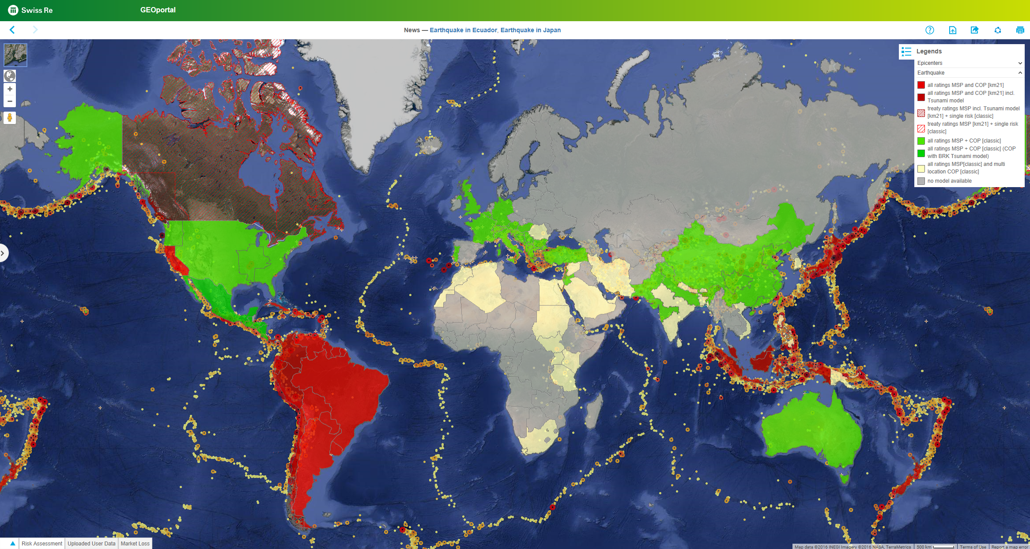
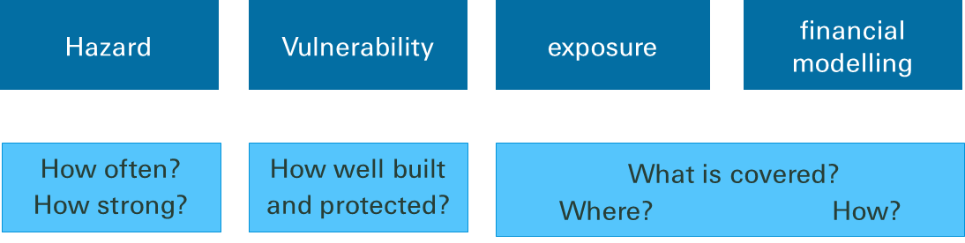
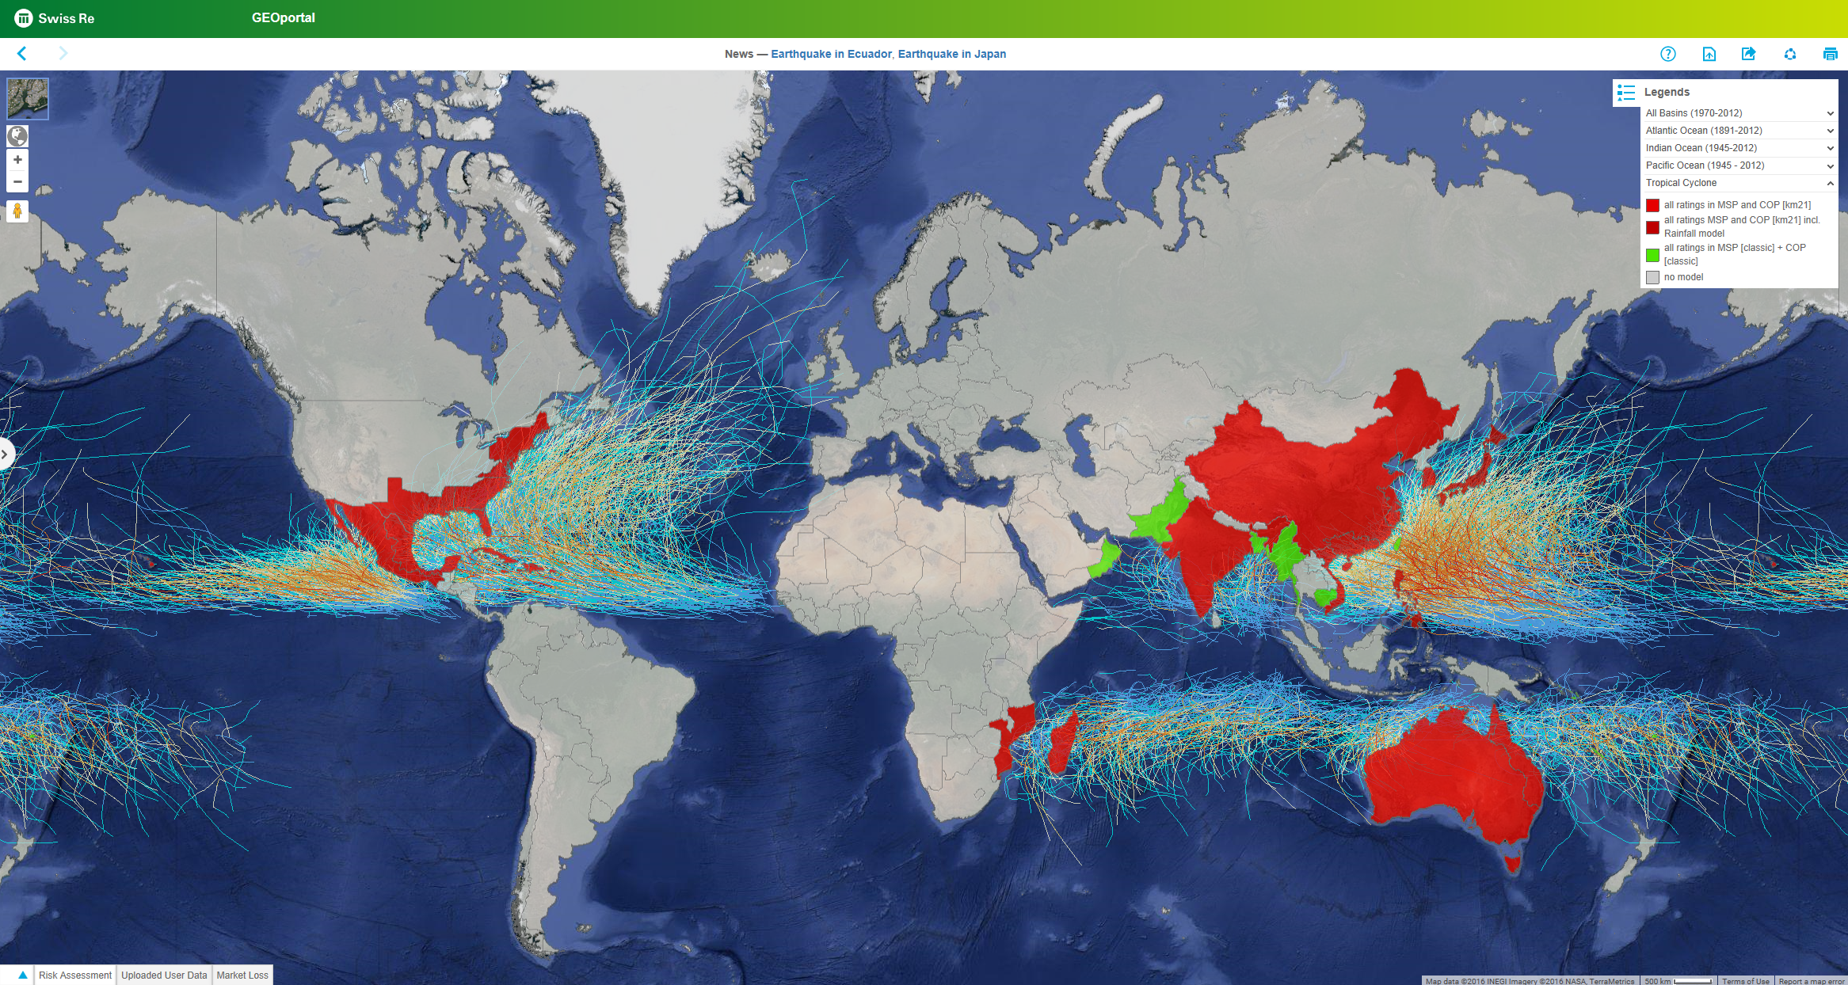
Cat Server 30-year experience in forward-looking Nat Cat model development
Context | Swiss Re’s proprietary Nat Cat loss model Simulates probabilistic events considering historic events and climate models Allows assessing the risk of extreme events beyond observed loss history
Drivers
Advantages | We know what is inside Unique geographic and peril scope (→ wind, earthquake, flood, hail, volcano, tsunami, storm surge, ..) Fully integrated into system landscape Allows to swiftly implement new insights after major events
Unique worldwide model coverage

Slide 24

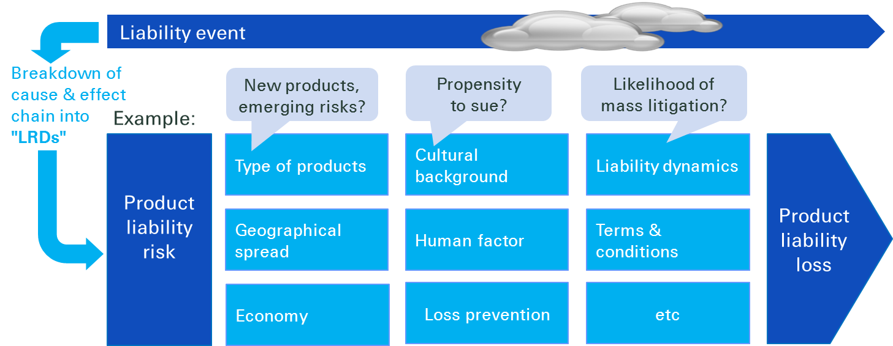
Liability Risk Driver (LRD ) The first forward-looking liability exposure model in the industry
Context | Calculates future liability losses by reflecting the mechanics and processes that drive them Provides a structured approach to → better assess liability risks in a changing environment → assess risks beyond historical experience data → model casualty catastrophic events | Applicable for public and product liability for both treaty and single risk Geographic relevance: dark blue = full model developed
Drivers

Slide 25
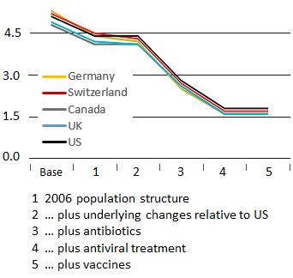
Pandemic model Mature, but continually reviewed
Context | Simulates daily evolution of a pandemic influenza worldwide from inception to containment Returns excess mortality for different age groups and regions
Drivers | Epidemiological features of virus derived from random, historic samples Difference to 1918 influenza (= “base”): → Medical and healthcare advances (antibiotics, vaccines, antivirals) → Demographic changes → Stronger interaction/travelling
Inputs
Lethality
Reproduction number (spread capability)
Random variables
Virus features
Simulated pandemic
Demographics
Interventions
Modelled pandemic mortality
Excess mortality (per mille)
1 Population structure
2 … plus underlying changes relative to US
3 … plus antibiotics
4 … plus antiviral treatment
5 … plus vaccines

Slide 26
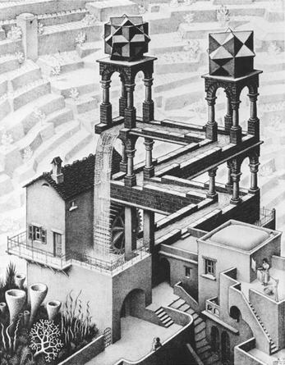
"All models are wrong…, but some are useful"
George Box

Slide 27
"A fool with a tool … is still a fool"
Stefan Lippe

Slide 29
Cautionary note on forward-looking statements
Certain statements and illustrations contained herein are forward-looking. These statements (including as to plans objectives, targets and trends) and illustrations provide current expectations of future events based on certain assumptions and include any statement that does not directly relate to a historical fact or current fact.
Forward-looking statements typically are identified by words or phrases such as “anticipate“, “assume“, “believe“, “continue“, “estimate“, “expect“, “foresee“, “intend“, “may increase“ and “may fluctuate“ and similar expressions or by future or conditional verbs such as “will“, “should“, “would“ and “could“. These forward-looking statements involve known and unknown risks, uncertainties and other factors, which may cause Swiss Re’s actual results of operations, financial condition, solvency ratios, capital or liquidity positions or prospects to be materially different from any future results of operations, financial condition, solvency ratios, capital or liquidity positions or prospects expressed or implied by such statements or cause Swiss Re to not achieve its published targets. Such factors include, among others:
further instability affecting the global financial system and developments related thereto;
deterioration in global economic conditions;
Swiss Re’s ability to maintain sufficient liquidity and access to capital markets, including sufficient liquidity to cover potential recapture of reinsurance agreements, early calls of debt or debt-like arrangements and collateral calls due to actual or perceived deterioration of Swiss Re’s financial strength or otherwise;
the effect of market conditions, including the global equity and credit markets, and the level and volatility of equity prices, interest rates, credit spreads, currency values and other market indices, on Swiss Re’s investment assets;
changes in Swiss Re’s investment result as a result of changes in its investment policy or the changed composition of its investment assets, and the impact of the timing of any such changes relative to changes in market conditions;
uncertainties in valuing credit default swaps and other credit-related instruments;
possible inability to realise amounts on sales of securities on Swiss Re’s balance sheet equivalent to their mark-to-market values recorded for accounting purposes;
the outcome of tax audits, the ability to realise tax loss carryforwards and the ability to realise deferred tax assets (including by reason of the mix of earnings in a jurisdiction or deemed change of control), which could negatively impact future earnings;
the possibility that Swiss Re’s hedging arrangements may not be effective;
the lowering or loss of one of the financial strength or other ratings of one or more Swiss Re companies, and developments adversely affecting Swiss Re’s ability to achieve improved ratings;
the cyclicality of the reinsurance industry;
uncertainties in estimating reserves;
uncertainties in estimating future claims for purposes of financial reporting, particularly with respect to large natural catastrophes, as significant uncertainties may be involved in estimating losses from such events and preliminary estimates may be subject to change as new information becomes available;
the frequency, severity and development of insured claim events;
acts of terrorism and acts of war;
mortality, morbidity and longevity experience;
policy renewal and lapse rates;
extraordinary events affecting Swiss Re’s clients and other counterparties, such as bankruptcies, liquidations and other credit-related events;
current, pending and future legislation and regulation affecting Swiss Re or its ceding companies, and the interpretation of legislation or regulations by regulators;
legal actions or regulatory investigations or actions, including those in respect of industry requirements or business conduct rules of general applicability;
changes in accounting standards;
significant investments, acquisitions or dispositions, and any delays, unexpected costs or other issues experienced in connection with any such transactions;
changing levels of competition; and
operational factors, including the efficacy of risk management and other internal procedures in managing the foregoing risks.
These factors are not exhaustive. Swiss Re operates in a continually changing environment and new risks emerge continually. Readers are cautioned not to place undue reliance on forward-looking statements. Swiss Re undertakes no obligation to publicly revise or update any forward-looking statements, whether as a result of new information, future events or otherwise.
This communication is not intended to be a recommendation to buy, sell or hold securities and does not constitute an offer for the sale of, or the solicitation of an offer to buy, securities in any jurisdiction, including the United States. Any such offer will only be made by means of a prospectus or offering memorandum, and in compliance with applicable securities laws.
Notes:
29

Slide 30
Legal notice
©2017 Swiss Re. All rights reserved. You are not permitted to create any modifications or derivative works of this presentation or to use it for commercial or other public purposes without the prior written permission of Swiss Re.
The information and opinions contained in the presentation are provided as at the date of the presentation and are subject to change without notice. Although the information used was taken from reliable sources, Swiss Re does not accept any responsibility for the accuracy or comprehensiveness of the details given. All liability for the accuracy and completeness thereof or for any damage or loss resulting from the use of the information contained in this presentation is expressly excluded. Under no circumstances shall Swiss Re or its Group companies be liable for any financial or consequential loss relating to this presentation.

